Slide 1


BUILD YOUR FIRST IOT APP

Slide 2
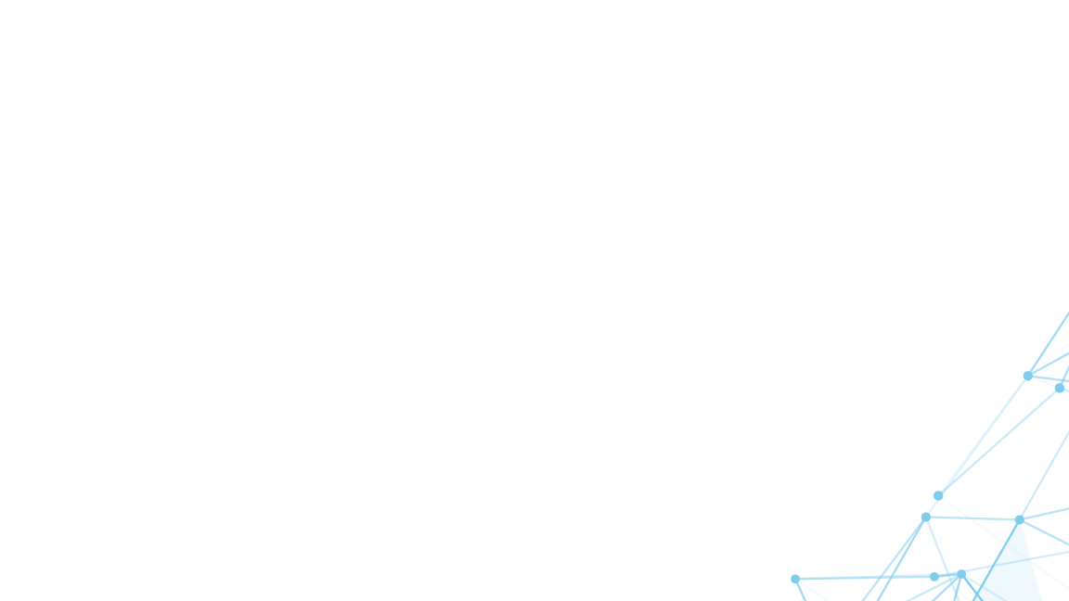
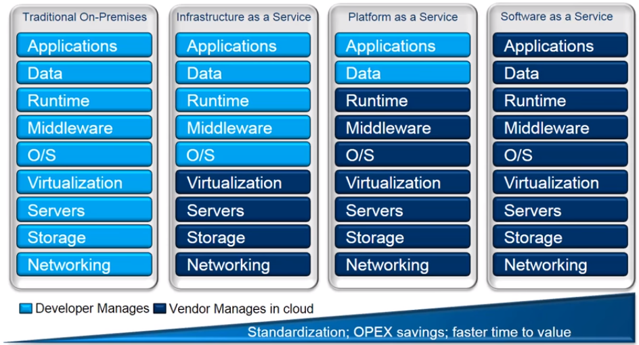
Cloud Computing: IaaS, PaaS, SaaS

Slide 3
Data ingestion: Ingress of data at scale to the cloud.
Device identity: Manage unique device identities and control device access to the solution.
Device management: Manage device metadata and perform operations such as device reboots and firmware upgrades.
Command and control: To cause the device to take an action, send messages to a device from the cloud.
Rules and actions: To act on specific device-to-cloud data, the solution back end uses rules.
Predictive analytics: The solution back end analyses device-to-cloud data to predict when specific actions should take place. For example, analysing aircraft engine telemetry to determine when engine maintenance is due.

Slide 4
Turn your Smartphone into an IOT Device
You'll use an IOT Starter Mobile app on your smartphone.
(which provides the list of simple commands that your smartphone can interpret)
To transform your smartphone into a sensor, we will build an IOT app that
Reads the accelerometer values that are sent from your smartphone and
Reacts with a specific action whether the values reach a certain threshold
E.g: When your smartphone is falling down or moving too fast and its acceleration
exceeds a certain threshold limit, you will be alerted
To transform your smartphone into an actuator, we will build an IOT app that
Sends specific commands to your smartphone
Can react to the commands it receives.
E.g.: For instance, based on the position of your smartphone,
we will turn on or off the light or change the background color of your smartphone.
What you'll need to build these IoT apps
An IBM Cloud account.
A smartphone (an Android or iOS smartphone).
For an iOS smartphone, a valid iOS Developer License and Apple Xcode.
A twitter account to be notified by a tweet (optional).
An email account with SMTP relay capabilities to be notified by an email message (optional).

Slide 5
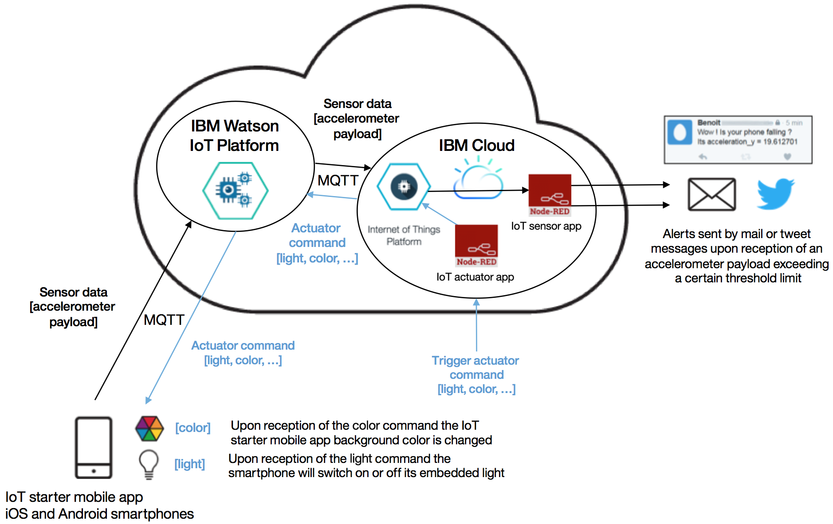
Architecture

Slide 6
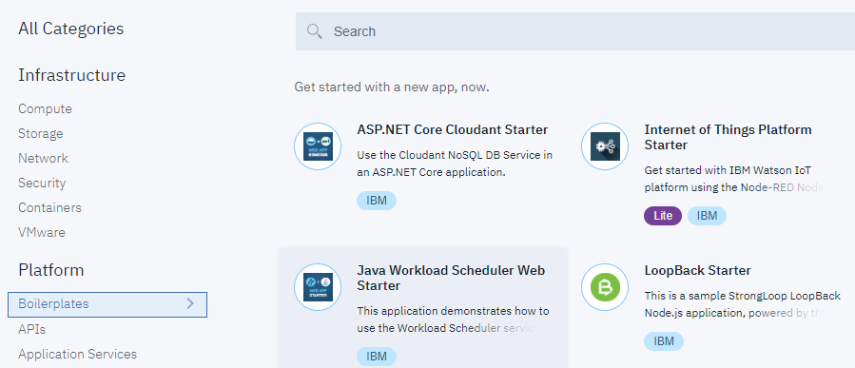
STEP 1: Create your main IOT app in the IBM Cloud
Our main IoT app in IBM Cloud will be our backend application in our IOT solution. Our backend application will read, receive, and interpret incoming payload messages that contain sensor data. Additionally, it will define and send IoT commands to actuators based on certain conditions being met.
Log in to your IBM Cloud account.
In the IBM Cloud catalog, from the Boilerplates section, select the Internet of Things Platform Starter boilerplate.

Slide 7
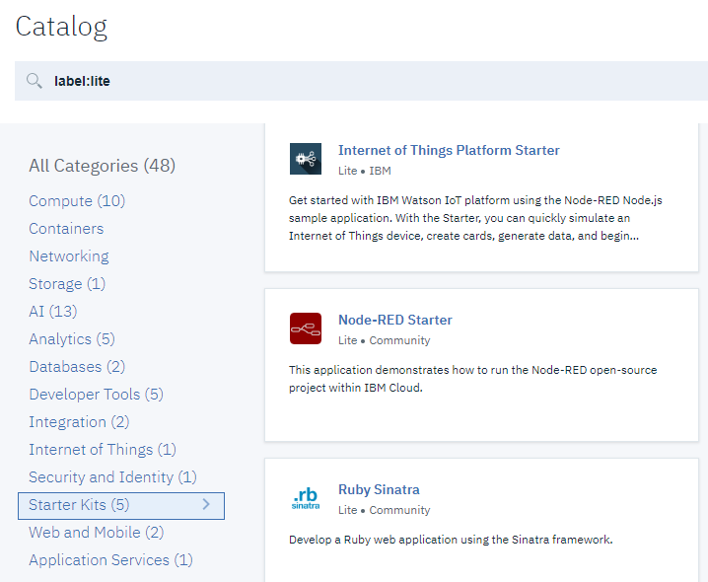
STEP 1: Create your main IOT app in the IBM Cloud
Our main IoT app in IBM Cloud will be our backend application in our IOT solution. Our backend application will read, receive, and interpret incoming payload messages that contain sensor data. Additionally, it will define and send IoT commands to actuators based on certain conditions being met.
Log in to your IBM Cloud account.
In the IBM Cloud catalog, from the Boilerplates section, select the Internet of Things Platform Starter boilerplate.

Slide 8
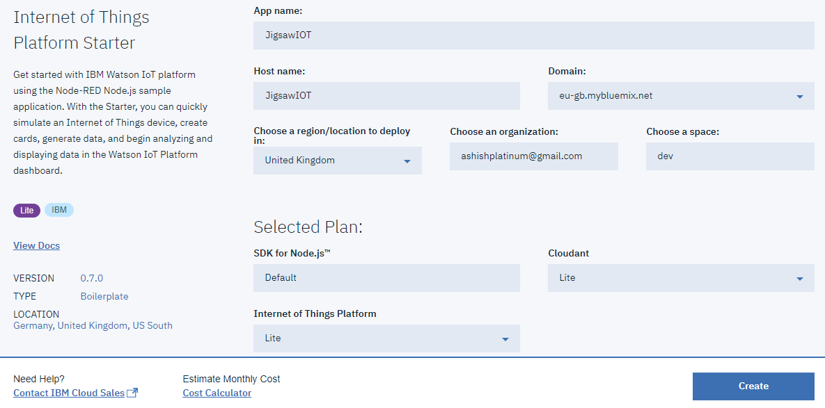
STEP 1: Create your main IOT app in the IBM Cloud
In the right pane, specify a unique name for your app, which is used to create a unique host name for your app. Then, click Create.
The Internet of Things Platform Starter boilerplate automatically adds the Internet of Things Platform service and a Cloudant NoSQL Database service to your app. It also includes a Node-RED runtime environment for your app.

Slide 9
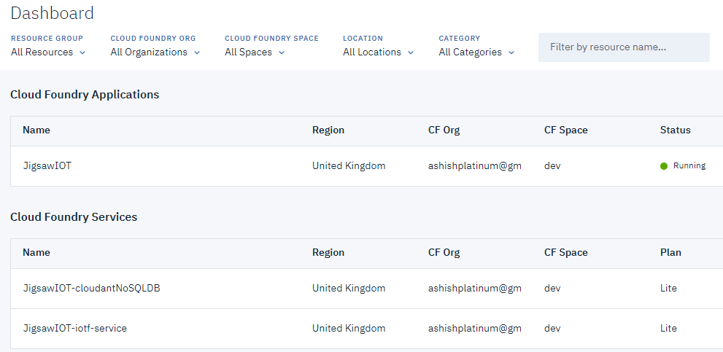
STEP 1: Create your main IOT app in the IBM Cloud

Slide 10
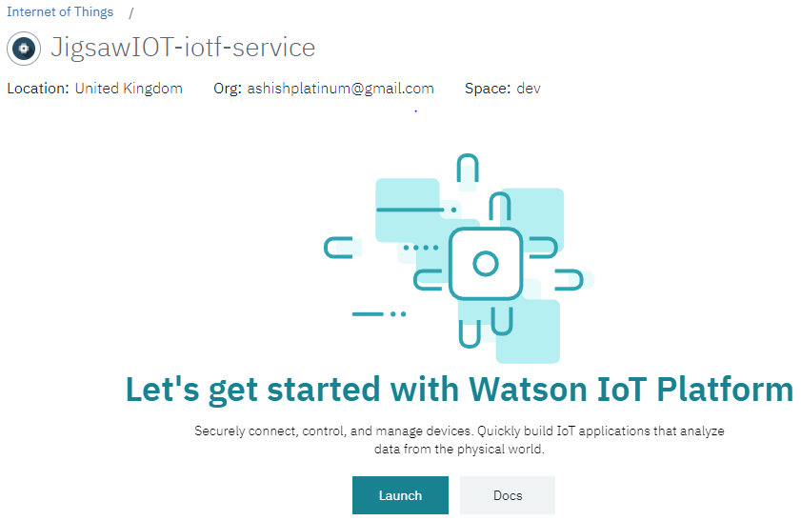
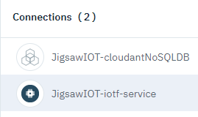
STEP 2: Register your smartphone
You need to register your smartphone in the Watson IOT Platform before you can connect it to the IoT. The Watson IOT Platform service automatically allocates an IOT organization to you. An IOT organization is a space that is used for connecting and managing devices to the Watson IoT Platform so that your applications can access their live and historical data.
In the Overview view of your app, under Connections, click the Internet of Things Platform service, named something like iot<your name>-iotf-service. Then click launch.
Notes:
https://console.bluemix.net/docs/cli/index.html#overview

Slide 11
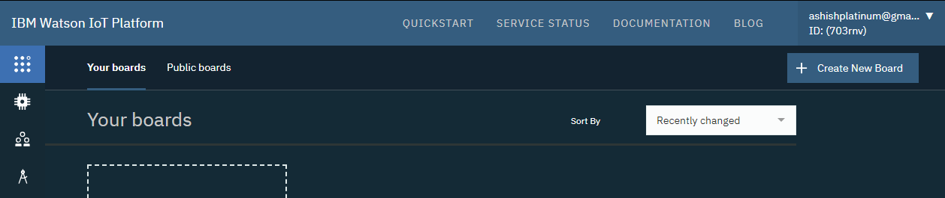
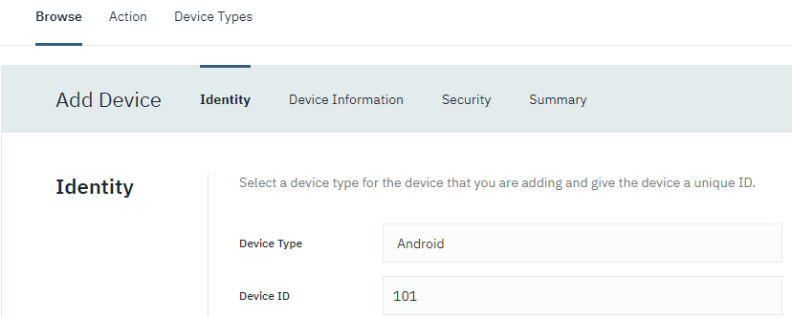
STEP 2: Register your smartphone
The dashboard for IBM Watson IoT Platform opens in a new browser tab. The organization ID is assigned to your app and is displayed in the upper right. You will need this ID later for configuring the mobile app. Below, the organization ID is (703rnv)
On the left menu, which pops out when you hover over it, click Devices. Then, click Add a device type. In your organization, you can have multiple device types each with multiple devices. A device type is a group of devices that share characteristics; In our case, the device type name must be "Android" (this device type name is required by the app that you will use later).

Slide 12
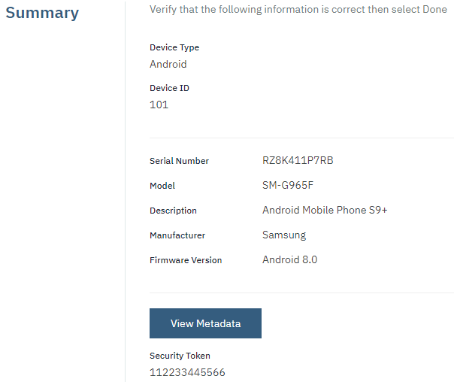
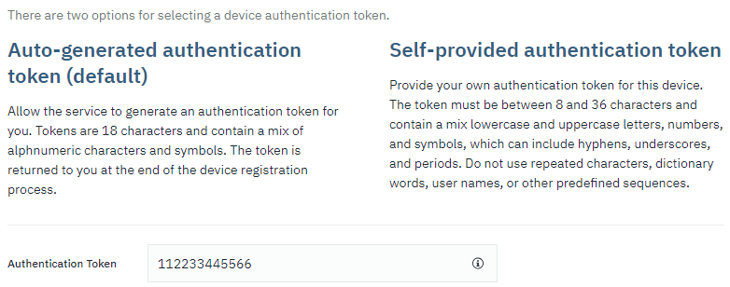
STEP 2: Register your smartphone
Click Next. A page is displayed where you can enter metadata about the device type, such as a serial number or model. You don't need to specify this information for this demo. Just click Done.
Provide a value for the authentication token. Remember this value for later. Then, click Next.
Click Done.
Notes:
https://703rnv.internetofthings.ibmcloud.com/dashboard/#/devices/browse-v2

Slide 13
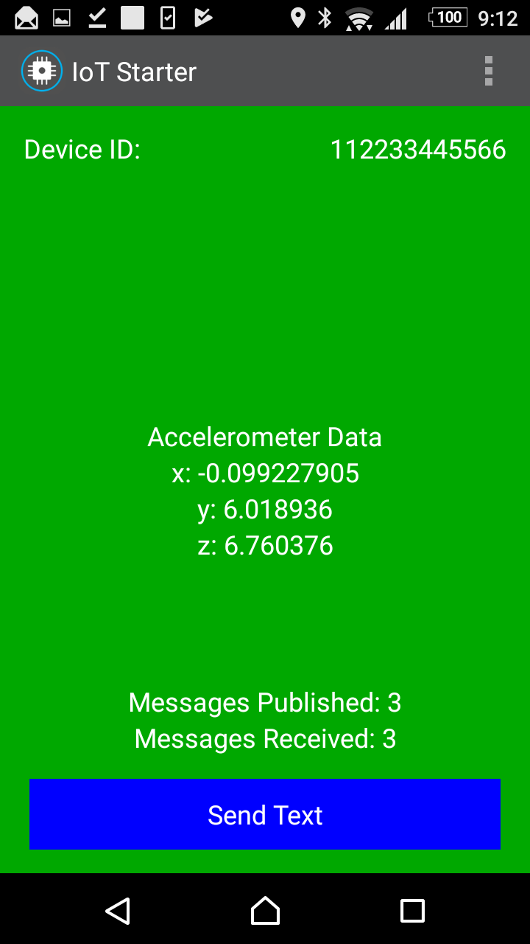
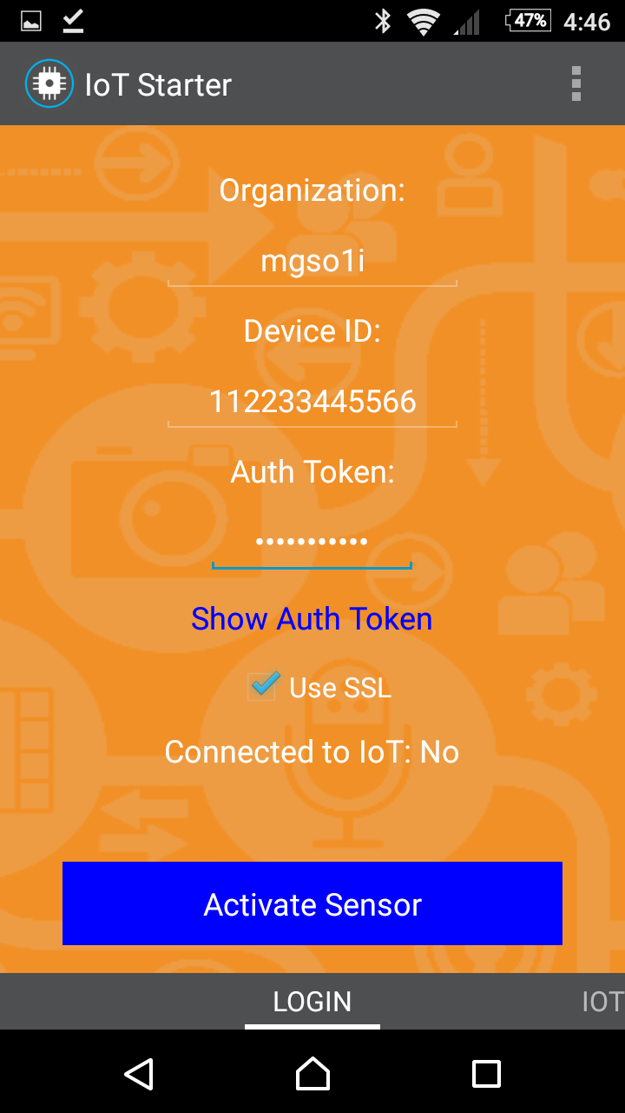
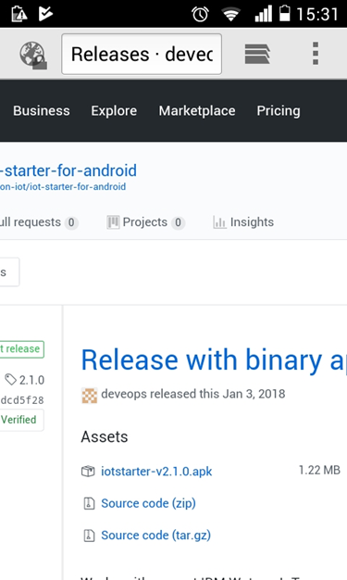
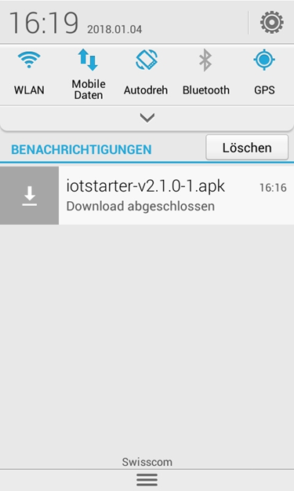
STEP 3: Prepare the Android Phone
On your phone, go to Settings > Security. Under Device Administration, enable Unknown sources. Now you can install .apk files from outside of Google Play.
Open the browser on your phone, and enter this URL:
https://github.com/deveops/iot-starter-for-android/releases
Search for the iotstarter-v2.1.0.apk link, and click the link to download the .apk file.
Click the downloaded file, and confirm that you want to install the app.
The IoT Starter app is now installed on your Android device.

Slide 14
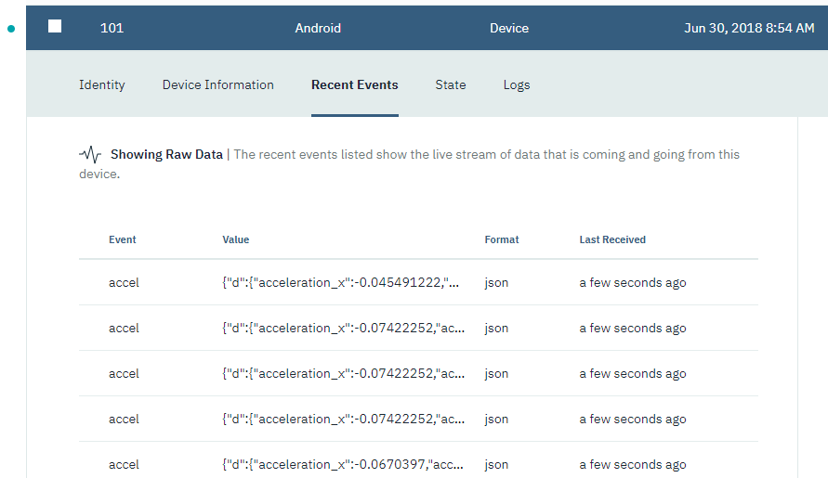
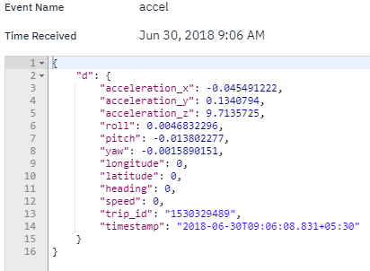
STEP 4: Verify messages are getting delivered
Click one of the events. The messages that are sent from your smartphone are in JSON format. They contain acceleration and position data.

Slide 15
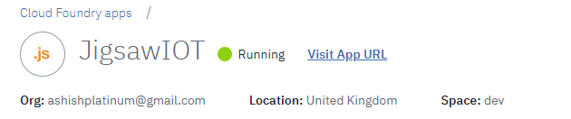
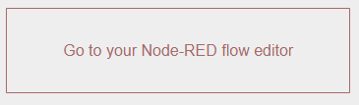
STEP 5: Process messages in a Node-RED flow
Node-RED is a visual tool that makes it easy to wire and process Internet of Things messages.
Now, we will enhance our IBM Cloud IOT app by using a Node-RED flow to process messages from your smartphone, and then send messages back to your smartphone. The phone will react on these messages by changing the background color in the app.
Launch your app - https://jigsawiot.eu-gb.mybluemix.net/
Open Node-RED flow editor - https://jigsawiot.eu-gb.mybluemix.net/red/
The editor opens, containing a sample flow.
Using the drag-and-drop features of this editor, you can plug together a flow of messages.
Although you can create your own flow here, we will import the code below. But first, select all existing nodes, and delete them by pressing the Delete key.

Slide 16
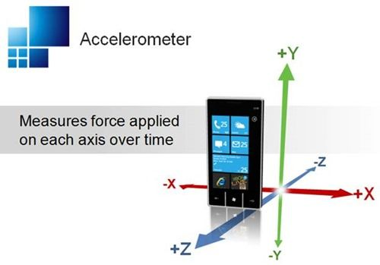

Slide 17
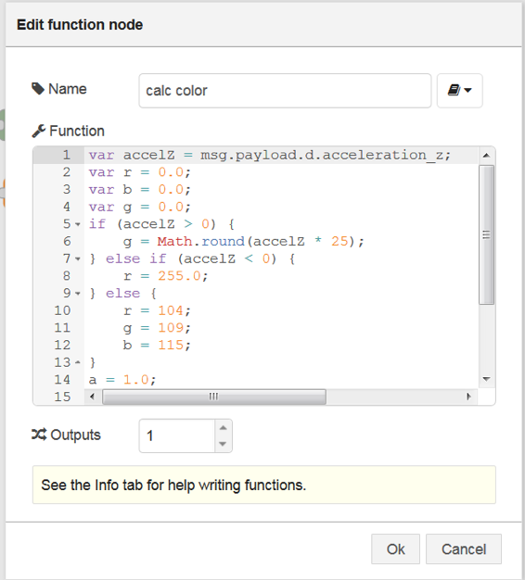
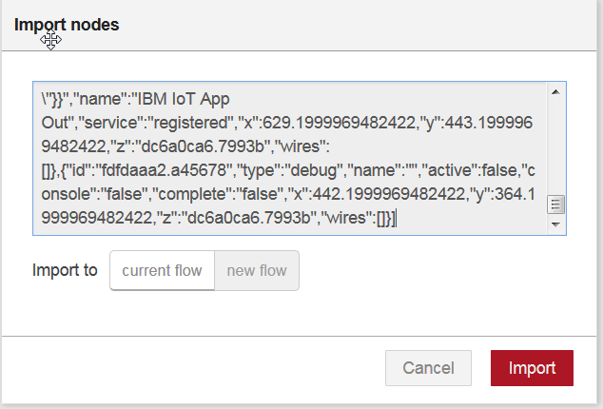
STEP 5a: Simple flow
Download the code (as a long single line of code) as a text file (nodeRedCode.txt) from GitHub.
In the Node-RED editor, press Ctrl-I to open the Import Nodes dialog. Paste the code, and click OK.
Now you need to adapt the flow to your specific parameters. The only relevant parameter is the Device ID. Double-click the node IBM IoT App out. In the pop-up window, enter the Device ID that you used earlier (for example, 101), and click Import.
Inspect the flow. Double-click the calc color node. It calculates the red, green, and blue values based on the incoming z-acceleration value, and passes them on as JSON data.

Slide 18
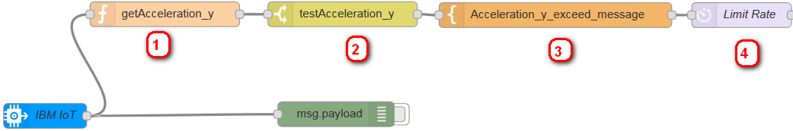
STEP 5b: Send alert when phone falls
Extract the "acceleration_y" value from the JSON payload message
Trigger a value against an acceleration value (such as 7 for Android)
Debug the notification message
Optionally, either post a tweet or send an email
To extract the absolute acceleration_y value of the smartphone from the JSON payload message, we'll add and configure a function node. From the function section of the palette, drag a function node to your workspace. Double-click the function node to configure it with these values:
Specify getAcceleration_y as the name for this node.
In this function node, copy and paste the following code:
return {payload: Math.abs(msg.payload.d.acceleration_y)};
Click Done.

Slide 19
STEP 5b: Send alert when phone falls
To create a trigger on the acceleration_y value, we'll add and configure a switch node. From the function section of the palette, drag a switch node to your workspace. Wire the function node to the switch node. Double-click the switch node to configure it with these values:
Specify testAcceleration_y as the name for this node.
Specify msg.payload as the property.
In the condition value drop-down list, select ">=?", and specify 0.5 for iOS or 7 for Android.
In the last drop-down list, select stopping after first match.
Click Done.
To define the notification message that you want to send when your phone is falling, we'll add and configure a template node. From the function section of the palette, drag a template node to your workspace. Wire the switch node to the template node. Double-click the template node to configure it with these values:
Specify Acceleration_y_exceed_message as the name for this node.
Specify msg.payload as the property.
Copy and paste the following code to the node editor:
Wow! Is your phone falling?
Its acceleration y = {{payload}}!
Click Done.

Slide 20
STEP 5b: Send alert when phone falls
To limit the number of messages for the notification and to avoid duplicate notification messages, we'll add and configure a delay node. From the function section of the palette, drag a delay node to your workspace. Wire the template node to the delay node. Double-click the delay node to configure it with these values:
Specify Limit Rate as the name for this node.
From the Action drop-down list, specify Limit rate to. Then, set the rate to 1 and select Minute.
Check the Drop intermediate message check box.
Click Done.
To define the notification message that you want to send when your phone is falling, we'll add and configure a template node. From the function section of the palette, drag a template node to your workspace. Wire the switch node to the template node. Double-click the template node to configure it with these values:
Specify Acceleration_y_exceed_message as the name for this node.
Specify msg.payload as the property.
Copy and paste the following code to the node editor:
Wow! Is your phone falling?
Its acceleration y = {{payload}}!
Click Done.
Double-click the twitter out node to configure it with these values:
In the twitter out dialog box, select the pencil icon next to the Twitter ID drop-down list.
In the next dialog box, click the button to authenticate with Twitter. In the window that is displayed, specify your Twitter credentials and authorize your IBM Cloud app to use your Twitter account.
Click Add to add that Twitter account.
In the twitter out dialog box, make sure that your ID is selected.

Slide 21
STEP 5b: Send alert when phone falls
If you have an SMTP email account, you can have the app send an email with the notification that your smartphone is falling. You might need to configure security settings for your email to allow your app to send email.
For example, if you are using a Gmail account, you must enable the Allow less secure apps option in the Sign-in & security settings.
Double-click the e-mail out node to configure it with these values:
In the To field, specify your email address.
In the Server field, specify your SMTP server address, such as smtp.gmail.com.
In the Port field, specify the SMTP TCP port that sends email, such as 465.
In the Userid field, specify the user name to use to authenticate with the SMTP server. This user name might be your email address.
In the Password field, specify the password that is associated with your user name.

Slide 22
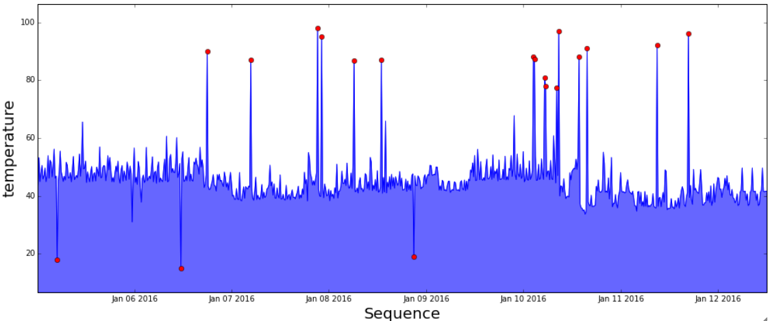
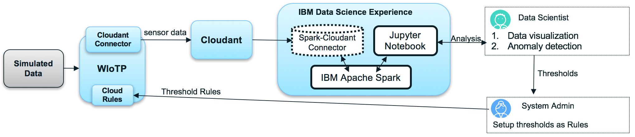
Next Steps – Anomaly Detection

Slide 23
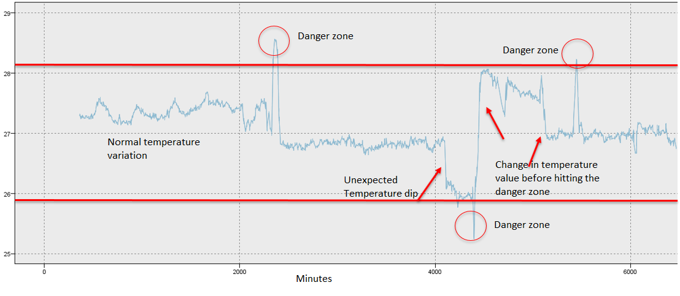
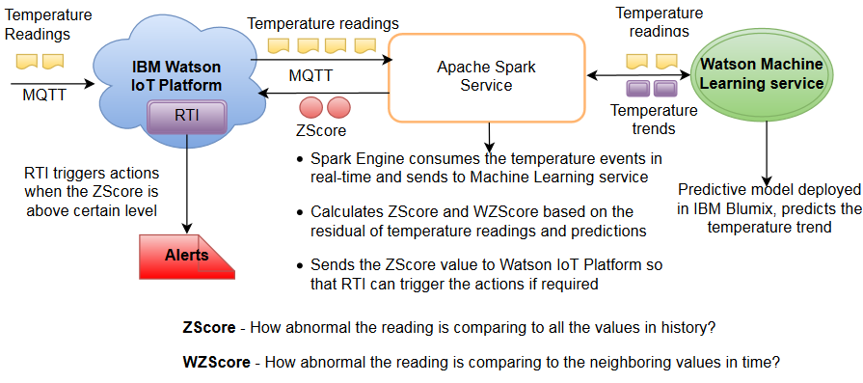
Machine Learning for detecting anomalous behaviours of things

Slide 24
https://github.com/deveops/iot-starter-for-android/releases/download/2.1.0/nodeRedCode.txt
Backup

Slide 25
https://github.com/deveops/iot-starter-for-android/releases
https://github.com/deveops/iot-starter-for-android/releases/download/2.1.0/nodeRedCode.txt

Slide 26
STEP 6: Plotting Acceleration
Download the code (as a long single line of code) as a text file (nodeRedCode.txt) from GitHub.
Rest of the code is here : https://www.ibm.com/developerworks/library/iot-mobile-phone-iot-device-bluemix-apps-trs/index.html

Slide 27
https://www.dropbox.com/sh/qgwmt3q1swmqeye/AACMK_RyYsHE4NIlVmAjDRP4a
Jigsaw@123$

Slide 28
Analysis using Watson Analytics Studio
Create account: https://www.ibm.com/cloud/watson-studio
https://github.com/ashish-jigsaw/workshop
New project for analysis
New notebook with URL -

